Slide 1

Module 6
Arrays, Lists, and Iteration

Slide 2
Iteration: For and Foreach Loops

Slide 3
Content (slot 2)
Iteration Control Structure
For Loops
Foreach Loops
Choosing Between For and Foreach Loops
Nested Loops
Arrays and Loops - "Walking the Array“
Exercise 23
Exercise 24
Blowing Up Teddies, Take 1
Blowing Up Teddies, Take 2
Putting It All Together
Common Mistakes

Slide 4

6.9 Iteration Control Structure
Example 6.1: Printing All the Cards in a Hand
Problem Description: Write an algorithm that will print out all the cards in a hand.
Algorithm

Slide 5
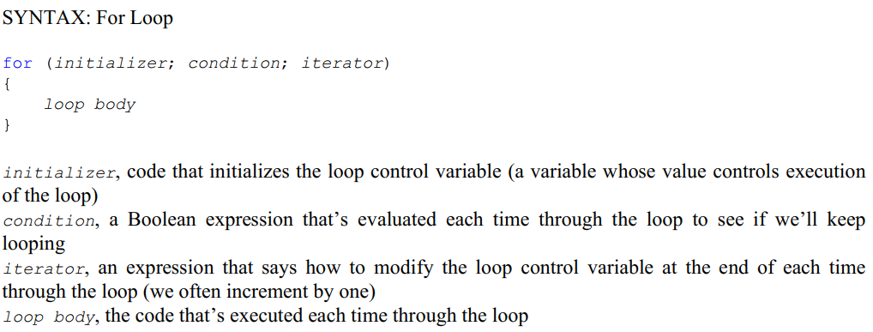
6.10 For Loops

Slide 6
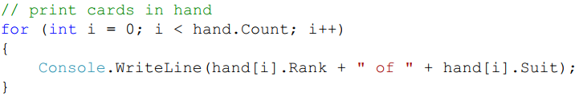
6.10 For Loops
Implement the code for the algorithm in Example 6.1
First add the start and end of the for loop
Example 6.2: Printing Squares of the Integers from 1 to n
Problem Description: Write a program that will print the squares of the integers from 1 to n, where n is provided by the user.

Slide 7

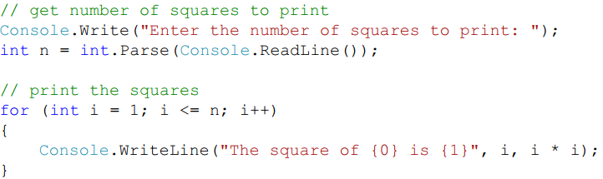
6.10 For Loops
Example 6.2: Printing Squares of the Integers from 1 to n
Algorithm
Implementation

Slide 8
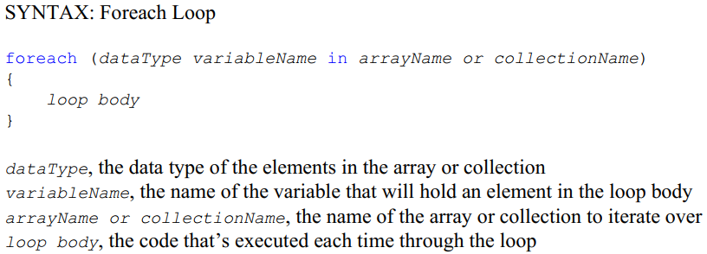
6.11 Foreach Loops

Slide 9
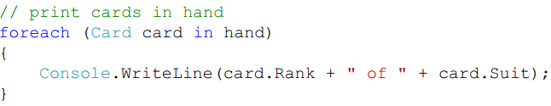
6.11 Foreach Loops
Print the cards in our hand again using a foreach loop

Slide 10
6.12 Choosing Between For and Foreach Loops
If we were trying to collect the locations of all the cards in the hand with a specific characteristic ➔ Use For loop.
If we want to execute the loop body a certain number of times but we're not processing the elements of an array or collection ➔ Use For loop.
If we actually want to change the contents of a collection we’re iterating over ➔ Use For loop.
If we’re not allowed to change the contents of a collection we’re iterating over ➔ Use Foreach loop.

Slide 11

6.13 Nested Loops
Example 10.3. Generating All the Cards in a Deck
Problem Description: Write a code fragment that will generate all the cards in a deck.
Initialize the deck of cards first using:
Algorithm

Slide 12
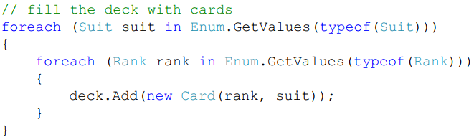
6.13 Nested Loops
Example 10.3. Generating All the Cards in a Deck
Implementation

Slide 13

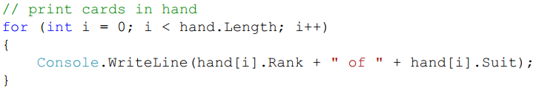
6.14 Arrays and Loops – “Walking the Array”
Example 10.4. Printing All the Cards in a Hand
Problem Description: Write an algorithm that will print out all the cards in a hand.
Algorithm
code only changes in one place (we use the Length property of the array rather than the Count property of the List):

Slide 14

6.14 Arrays and Loops – “Walking the Array”
Example 10.5. Adding Up the Numbers in a Grid
Problem Description: Add up all the numbers in a 3 by 4 grid of integers.
Algorithm
Declare the 2D array that holds the numbers

Slide 15
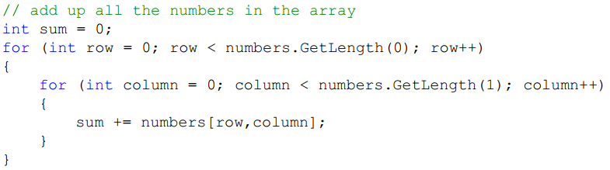
6.14 Arrays and Loops – “Walking the Array”
Example 10.5. Adding Up the Numbers in a Grid
Implementation

Slide 16
Exercise 23: Keeping the Odd
View LMS

Slide 17
Exercise 24: For and Foreach Loops
View LMS

Slide 19
6.15 Blowing Up Teddies, Take 1 ()
Page 229 of Textbook
Read yourself

Slide 20
6.16 Blowing Up Teddies, Take 2
Page 234 of Textbook
Read yourself

Slide 21
6.17 Putting It All Together
The problem description:
Start with a TeddyBear game object, centered in the window, not moving
On every right mouse click, add a Pickup game object where the mouse was clicked
When the player left clicks the TeddyBear, the teddy starts collecting the pickups, starting with the closest Pickup and targeting the closest Pickup each time it collects the Pickup currently “targeted for collection”
The TeddyBear collects a Pickup by colliding with it, but this only works for the Pickup the Teddy has currently “targeted for collection”
Once the last Pickup has been collected, the Teddy stops moving
If the player adds more Pickups while the Teddy is moving, the Teddy picks them up as well
If the player adds more Pickups while the Teddy is stopped, the player has to left click on the Teddy again to start it collecting again

Slide 22
6.17 Putting It All Together
Understand the Problem
What happens if the player places a new Pickup that's closer to the Teddy than the Pickup it's currently moving to collect. Should the Teddy change its target or should it keep heading toward the current targeted Pickup?
Having the Teddy keep heading toward the current targeted Pickup is the easier problem to solve.
Design a Solution
Need to make some changes to our TeddyBear and TedTheCollector scripts.

Slide 23
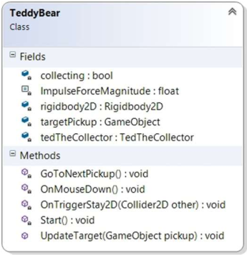
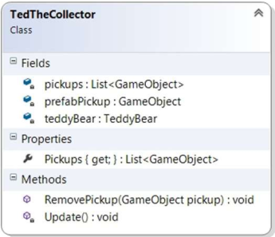
6.17 Putting It All Together
Design a Solution
TeddyBear and TedTheCollector UML

Slide 24
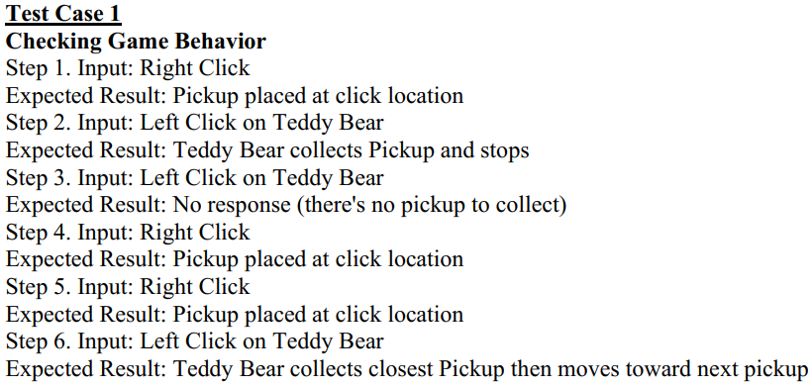
6.17 Putting It All Together
Write Test Cases

Slide 25

6.17 Putting It All Together
Write the Code
the TedTheCollector Pickups property
In the TeddyBear GoToNextPickup method, change a single line of code from
to

Slide 26
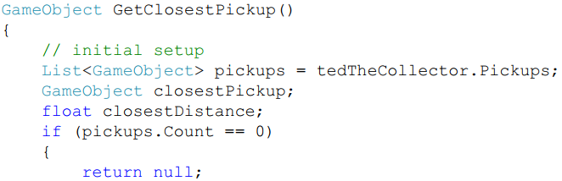
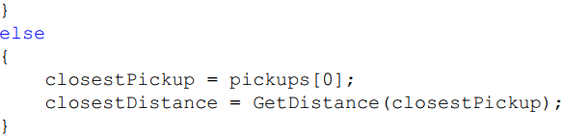
6.17 Putting It All Together
Write the Code
GetClosestPickup method

Slide 27
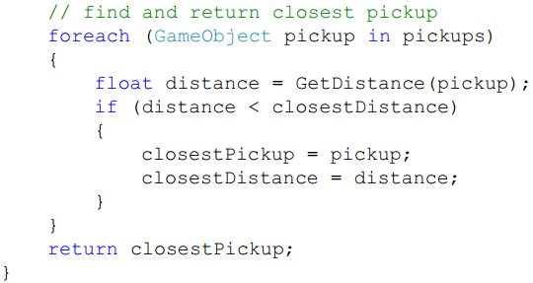
6.17 Putting It All Together
Write the Code
GetClosestPickup method

Slide 28
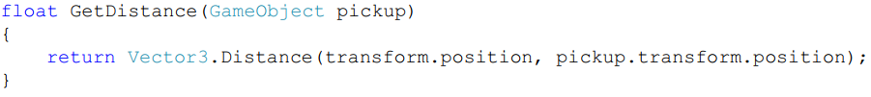
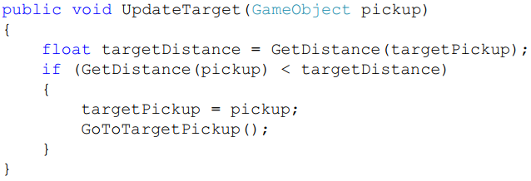
6.17 Putting It All Together
Write the Code
GetDistance method
TeddyBear UpdateTarget method

Slide 29

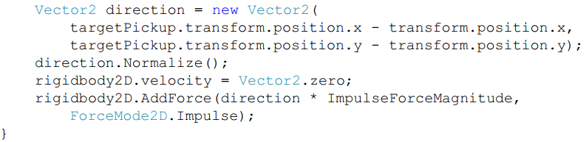
6.17 Putting It All Together
Write the Code
GoToTargetPickup method
and call this method from both the GoToNextPickup method and the UpdateTarget method.

Slide 30
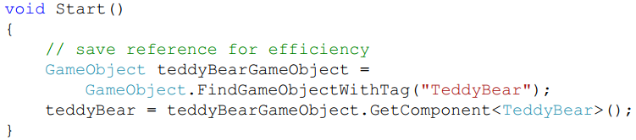

6.17 Putting It All Together
Write the Code
Start method
add the following code to the TedTheCollector Update method right after adding a new pickup to the scene

Slide 31

6.17 Putting It All Together
Test the Code
Error Message
Write the Code Again
The error message tells us that the error occurs at line 176 in the TeddyBear.cs file; that line is in the GetDistance method

Slide 32

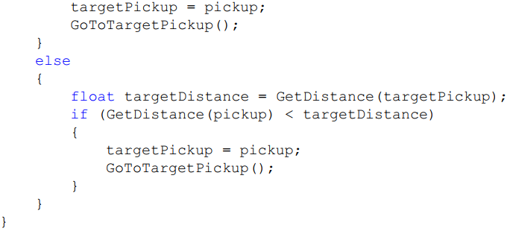
6.17 Putting It All Together
Test the Code
change the UpdateTarget method to

Slide 33

6.17 Putting It All Together
Test the Code
run the code again and ... ^&$*#$&#$!@$*@#
UpdateTarget method was crashing before it got to the call to the GoToTargetPickup method ➔ moves the Teddy Bear toward the target pickup even though it's not collecting yet.
Write the Code, Yet Again
In UpdateTarget method, pull the below two lines of code into a separate SetTarget method

Slide 34
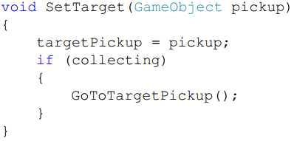
6.17 Putting It All Together
Test the Code
Now we always set the targetPickup field (as we should) but only start moving toward the (new) target pickup if the Teddy Bear is already collecting.

Slide 35
6.17 Putting It All Together
Test the Code, Yet Again
The Teddy Bear keeps moving toward its original targeted pickup, then keeps going past it without collecting it.
Write the Code (for the fourth time)
If we go to the code, right-click the collecting field, and select Find references, we discover that the field is never set in the code at all (except when it's initialized)! Let's fix that now.
First, we decide when collecting should be set to true. That should happen in the OnMouseDown method just before we call the GoToNextPickup method.
Next, we decide when collecting should be set to false. That should happen in the GoToNextPickup method if there are no more Pickups to be collected in the scene. We know that's the case if the GetClosestPickup method returns null when we call it.

Slide 36
6.18 Common Mistakes
Using the Wrong Condition in a For Loop
Changing the Array or Collection You're Iterating Over With a Foreach Loop

Slide 37
Module 6
Arrays, Lists, and Iteration

Slide 38
Iteration: While Loops

Slide 39
Content (slot 3)
Iteration Control Structure Revisited
While Loops
Testing While Loops
Do-While Loops
Spawning Into a Collision-Free Location
Putting It All Together
Common Mistakes

Slide 40
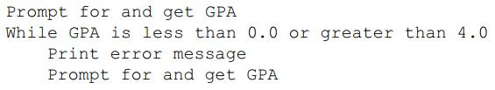
6.19 Iteration Control Structure Revisited
Example 6.1: Getting a Valid GPA
Problem Description
Write an algorithm that will ask for a GPA until a valid GPA is entered.
Algorithm

Slide 41
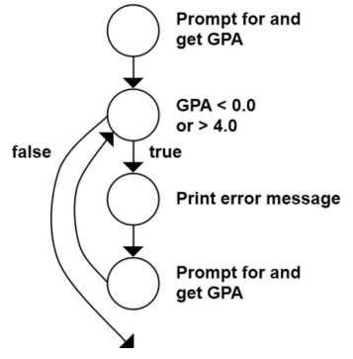
6.19 Iteration Control Structure Revisited
CFG for Example 6.1

Slide 42
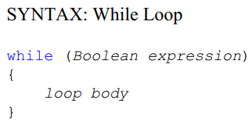
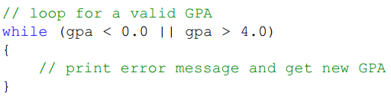
6.20 While Loops
Implement Example 6.1
add the while part of the loop

Slide 43
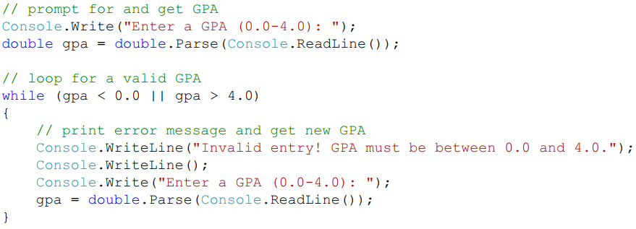
6.20 While Loops
Implement Example 6.1
implement the rest of the algorithm

Slide 44
6.20 While Loops
Implement Example 6.1
implement the rest of the algorithm

Slide 45
6.20 While Loops
ITM
Initialize the variables contained in the Boolean expression.
Tests the Boolean expression to see if the loop body should execute or not.
Modify at least one of the variables in the Boolean expression (give it a new value).
What happens if we forget about ITM?
Example 6.2: Printing Squares of the Integers from 1 to n
Problem Description:
Write a program that will print the squares of the integers from 1 to n, where n is provided by the user.

Slide 46
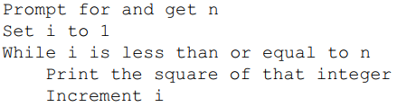
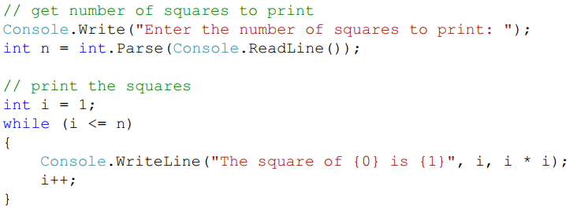
6.20 While Loops
Example 6.2: Printing Squares of the Integers from 1 to n
Algorithm:
Implementation

Slide 47
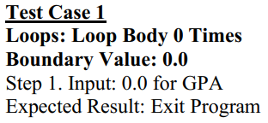
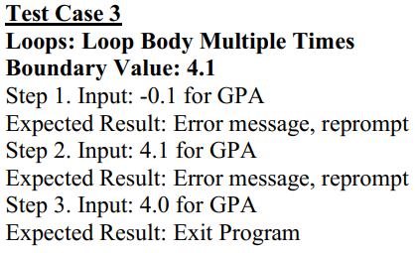
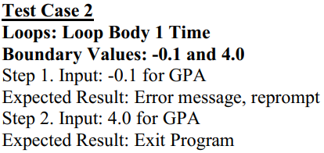
6.21 Testing While Loops

Slide 48
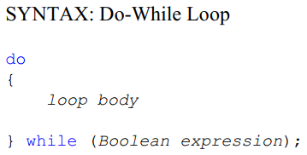
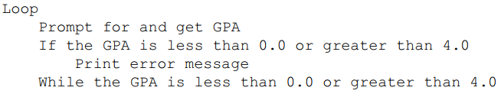
6.22 Do-While Loops
Algorithm of Example 6.1

Slide 49
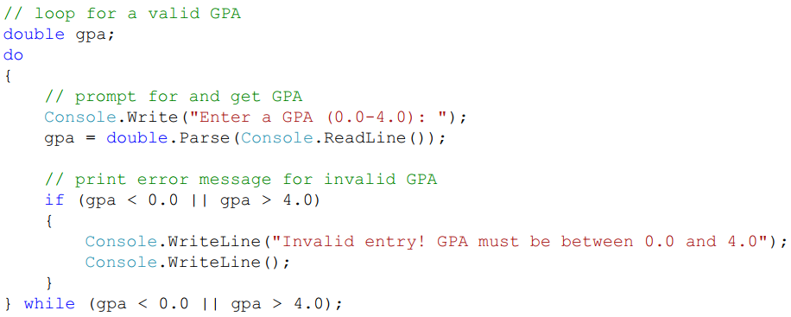
6.22 Do-While Loops
Implementation

Slide 50
6.23 Spawning Into a Collision-Free Location
In the Putting It All Together problem in Module 4, a teddy bear shouldn't be spawn on top of a teddy bear that's already in the game, but that we needed to know about while loops first. Now use while loops to solve this problem.
All work will be in the TeddyBearSpawner script because this problem needs to be handled when a new teddy bear is being spawn.
The big idea is that
We'll pick a random location for the teddy bear we're spawning, then check to see if the collider for the new teddy bear would collide with anything already in the game.
If it wouldn't, we spawn the teddy bear at that location and we're done. If it would collide with something, though, we randomly generate a new location and do the check again.
We keep doing this until we find a collision-free location for the new teddy bear or we decide to give up on this spawn attempt.

Slide 51
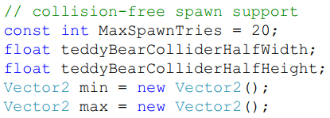
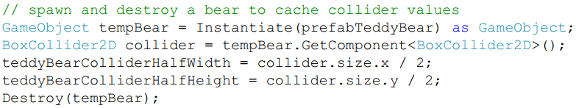
6.23 Spawning Into a Collision-Free Location
Add five more fields
Add code to the TeddyBearSpawner Start method to retrieve and save those dimensions

Slide 52
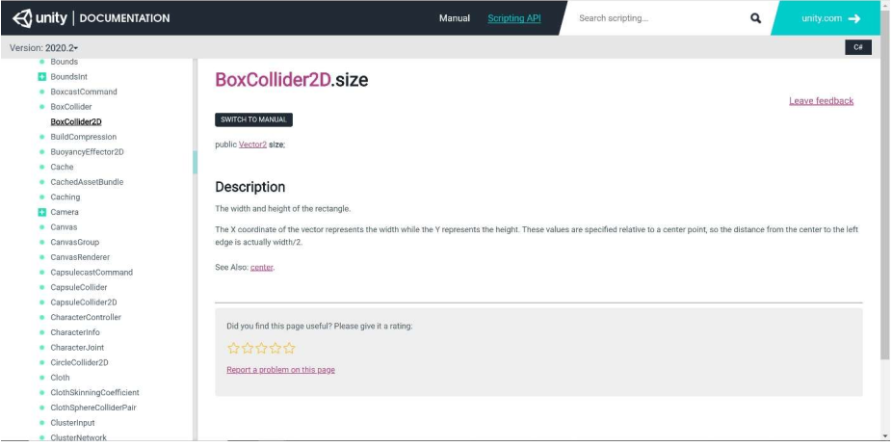
6.23 Spawning Into a Collision-Free Location
BoxCollider2D Size Documentation

Slide 53
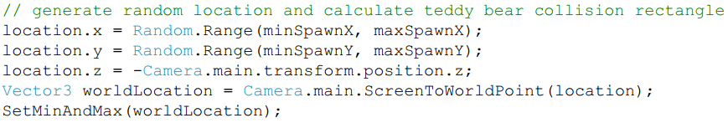
6.23 Spawning Into a Collision-Free Location
Final change is to the TeddyBearSpawner SpawnBear method. We replace the code we originally had to generate a random location and create the new teddy bear object with the following code.

Slide 54
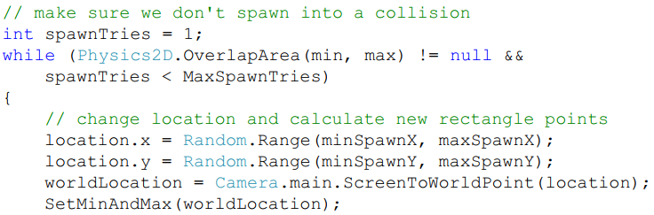

6.23 Spawning Into a Collision-Free Location

Slide 55
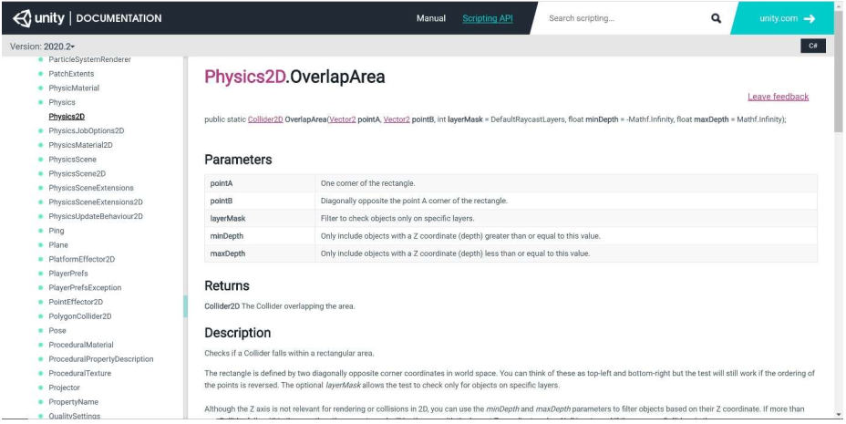
6.23 Spawning Into a Collision-Free Location
Physics2D OverlapArea Documentation

Slide 56
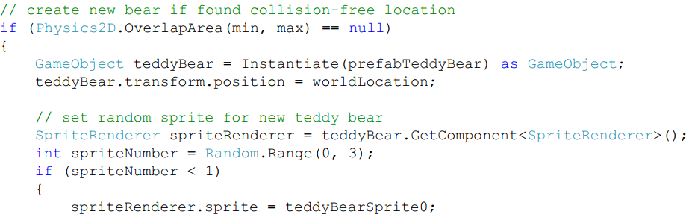
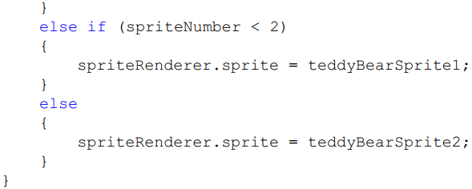
6.23 Spawning Into a Collision-Free Location
The code in the SpawnBear method

Slide 57
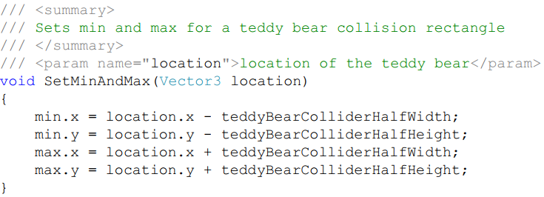
6.23 Spawning Into a Collision-Free Location
The SetMinAndMax method

Slide 58
6.24 Putting It All Together
The problem description
Develop a method that starts at a particular location in a list of strings, searching for the next occurrence of "inactive". The search needs to examine every string in the list, returning the index of the next occurrence of "inactive" or -1 if "inactive" doesn’t appear in the list.
Understand the Problem
To make sure we understand the problem, let’s think about all the possibilities for occurrences of "inactive" in the list (this will help us develop our test cases as well).
Design a Solution
develop a single method to solve this problem.
come up with an algorithm for the method before we implement the code.

Slide 59
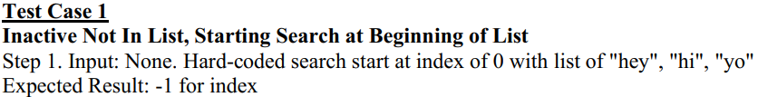
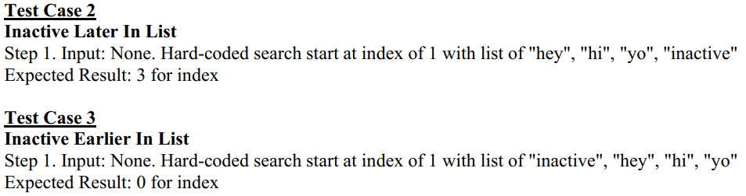
6.24 Putting It All Together
Write Test Cases

Slide 60
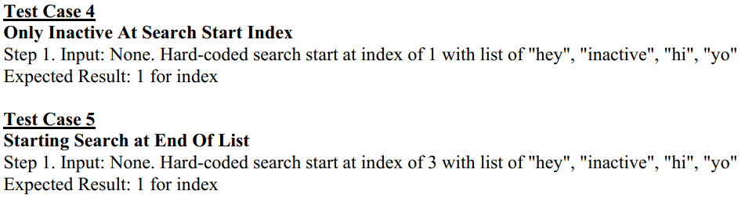
6.24 Putting It All Together
Write Test Cases

Slide 61
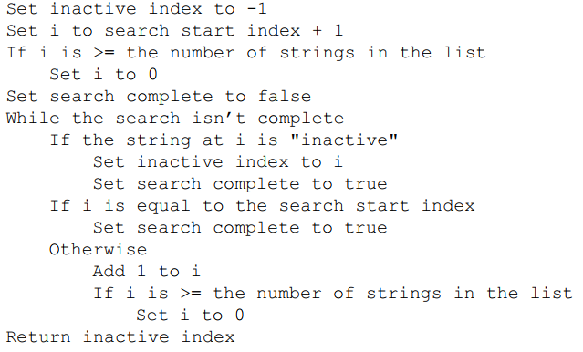
6.24 Putting It All Together
Write the Code
Algorithm: There are number of ways which can solve this problem

Slide 62
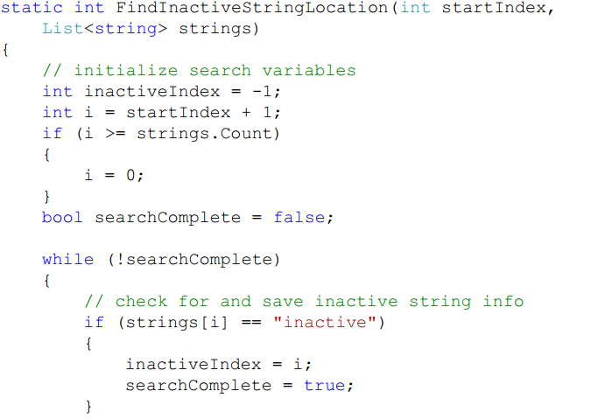
6.24 Putting It All Together
Write the Code

Slide 63
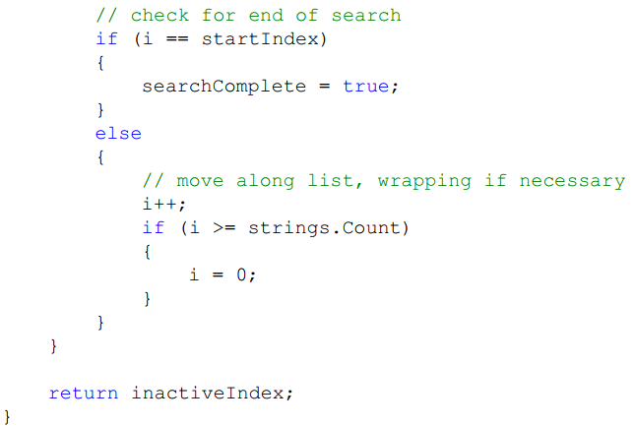
6.24 Putting It All Together
Write the Code

Slide 64
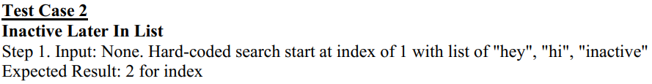
6.24 Putting It All Together
Test the Code
To get the loop body to execute once, we can provide a list where "inactive" is in the location immediately following the start location ➔ modify the list in Test Case 2 to cover this.

Slide 65
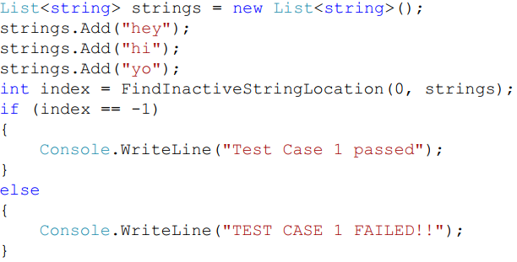
6.24 Putting It All Together
Test the Code
To test the code, we embedded the method we wrote into a console application and had the Main method in that application execute all the test cases for us. For example, code to execute Test Case 1:

Slide 66
6.25 Common Mistakes
Forgetting ITM in a Loop
make sure all the variables contained in the Boolean expression for the loop are initialized.
make sure that at least one of the variables in the Boolean expression is modified in the loop before get back to the test again
Using an If Statement Instead of a While Loop

Slide 67
Summary
Array
Collection Classes
For Loops
Foreach Loops
While Loops
Do-While Loops

